Slide 1
Azure Backups and Monitoring
Courtney Vallentyne
Notes:
IMPORTANT NOTE:
Microsoft Ready will utilize Windows 10 and the new PowerPoint 2016, as well as PowerPoint 2013 on all event machines. Please build your slides utilizing the appropriate Template and utilize the version of PowerPoint that works best.
Windows 10 devices now connect remotely through VPN using the PIN with Passport for Work. Speakers needing to use VPN in a demo, will need to have registered for Phone Authentication at https://phoneregistration.microsoft.com. Additional details are also available here: https://microsoft.sharepoint.com/sites/itweb/securelogon/Pages/FAQ.aspx

Slide 2
Control Matrix
Backup and backup policies, recovery time/point, alternate storage location
CP-6 (2) | Alternate Storage Site | Recovery Time / Point Objectives | CP-6 (2) | The organization configures the alternate storage site to facilitate recovery operations in accordance with recovery time and recovery point objectives. | All storage accounts deployed by this Azure Blueprint Automation are replicated to ensure high availability using geo-redundant storage (GRS). GRS ensures that data is replicated to a secondary region. Customers must ensure the Azure data replication model is compatible with contingency objectives.
CP-9 | Information System Backup | CP-9.a | The organization conducts backups of user-level information contained in the information system [Assignment: organization-defined frequency consistent with recovery time and recovery point objectives]. | This Azure Blueprint Automation deploys a Recovery Services Vault. User-level information in the deployed SQL database is implemented using the SQL VM IaaS extension.
CP-9 | Information System Backup | CP-9.b | The organization conducts backups of system-level information contained in the information system [Assignment: organization-defined frequency consistent with recovery time and recovery point objectives]. | This Azure Blueprint Automation deploys a Recovery Services Vault. An Azure Backup policy is established for all virtual machines implementing a daily, weekly, monthly, and yearly backup image retention.
CP-9 | Information System Backup | CP-9.d | The organization protects the confidentiality, integrity, and availability of backup information at storage locations. | Confidentiality and integrity of all storage blobs deployed by this Azure Blueprint Automation are protected through use of Azure SSE, which uses 256-bit AES encryption for all data-at-rest.
CP-9 (5) | Information System Backup | Transfer to Alternate Storage Site | CP-9 (5) | The organization transfers information system backup information to the alternate storage site [Assignment: organization-defined time period and transfer rate consistent with the recovery time and recovery point objectives]. | All deployed storage accounts within this Azure Blueprint Automation, including those used for backup, implement geo-redundant storage, ensuring six copies of all data are maintained on separate nodes across two data centers.

Slide 3
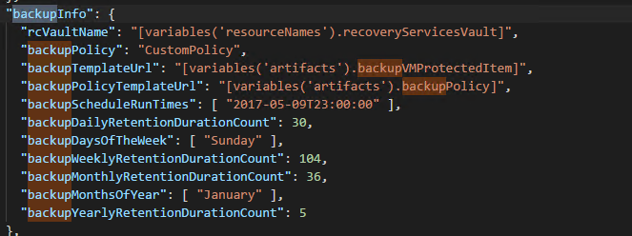
Backup Policies

Slide 4
Data Backup

Slide 5
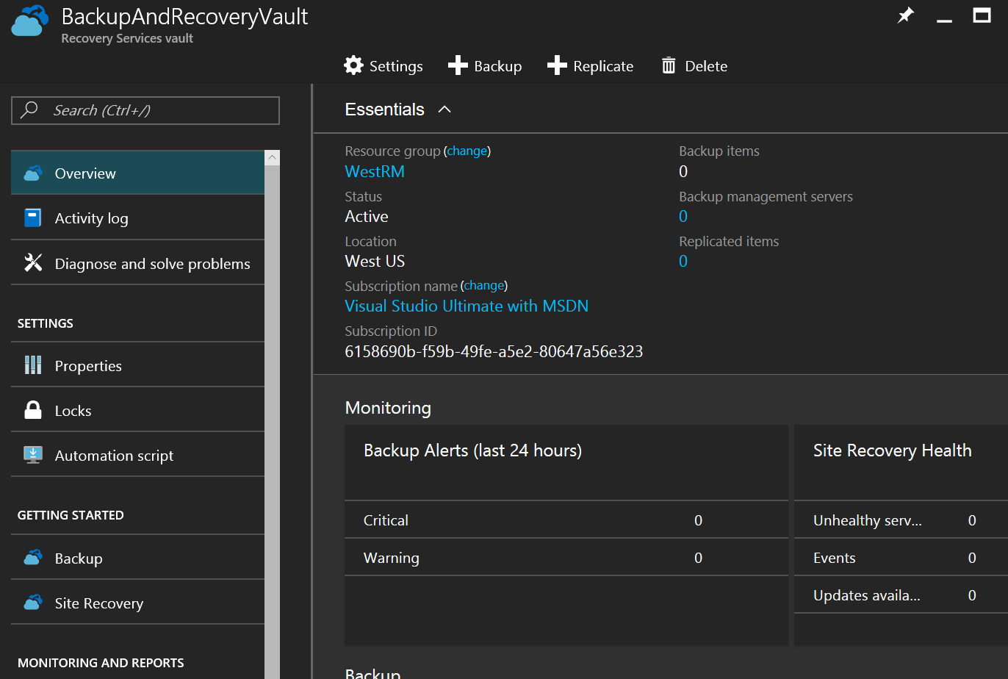
Recovery Services vault
https://docs.microsoft.com/en-us/azure/backup/backup-azure-vms-introduction

Slide 6
Recovery Services Vault: GeoRedundant Storage
Get-AzureRmRecoveryServicesvault |
Get-AzureRmRecoveryServicesBackupProperties
BackupStorageRedundancy
-----------------------
GeoRedundant

Slide 7
Azure Backup benefits
Cloud as a backup endpoint (replacing tape)
Automatic storage management – Automatically allocates and manages backup storage, and uses a pay-as-you-use model
Unlimited scaling – Underlying power and unlimited scale of the Azure cloud
Multiple storage options – LRS and GRS storage replication
Protect Premium Storage VMs

Slide 8
Azure Backup benefits
Unlimited data transfer – No limit on amount of inbound or outbound data you transfer
Data encryption – Data encryption allows for secure transmission and storage of your data; only you have encryption passphrase or key
Application-consistent backup – All required data to restore the backup copy; reduces the restoration time
Long-term retention – 99 years!

Slide 9
Monitoring and Dashboards

Slide 10
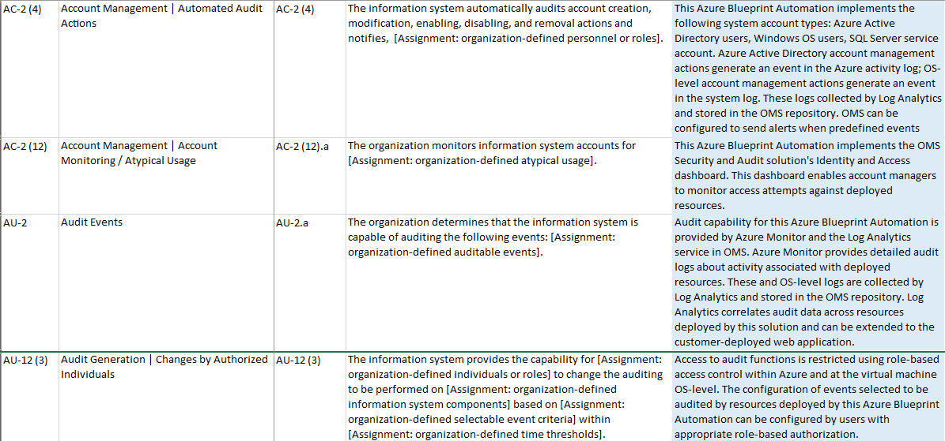
Audit and Monitoring

Slide 11
